Slide 1
Heinz Proposal
Cerig Davies

Slide 2
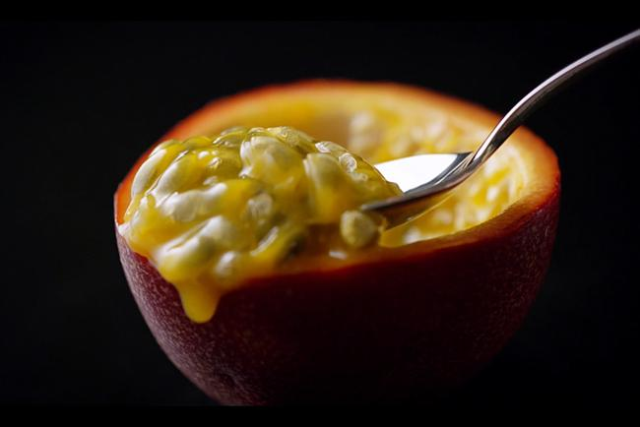
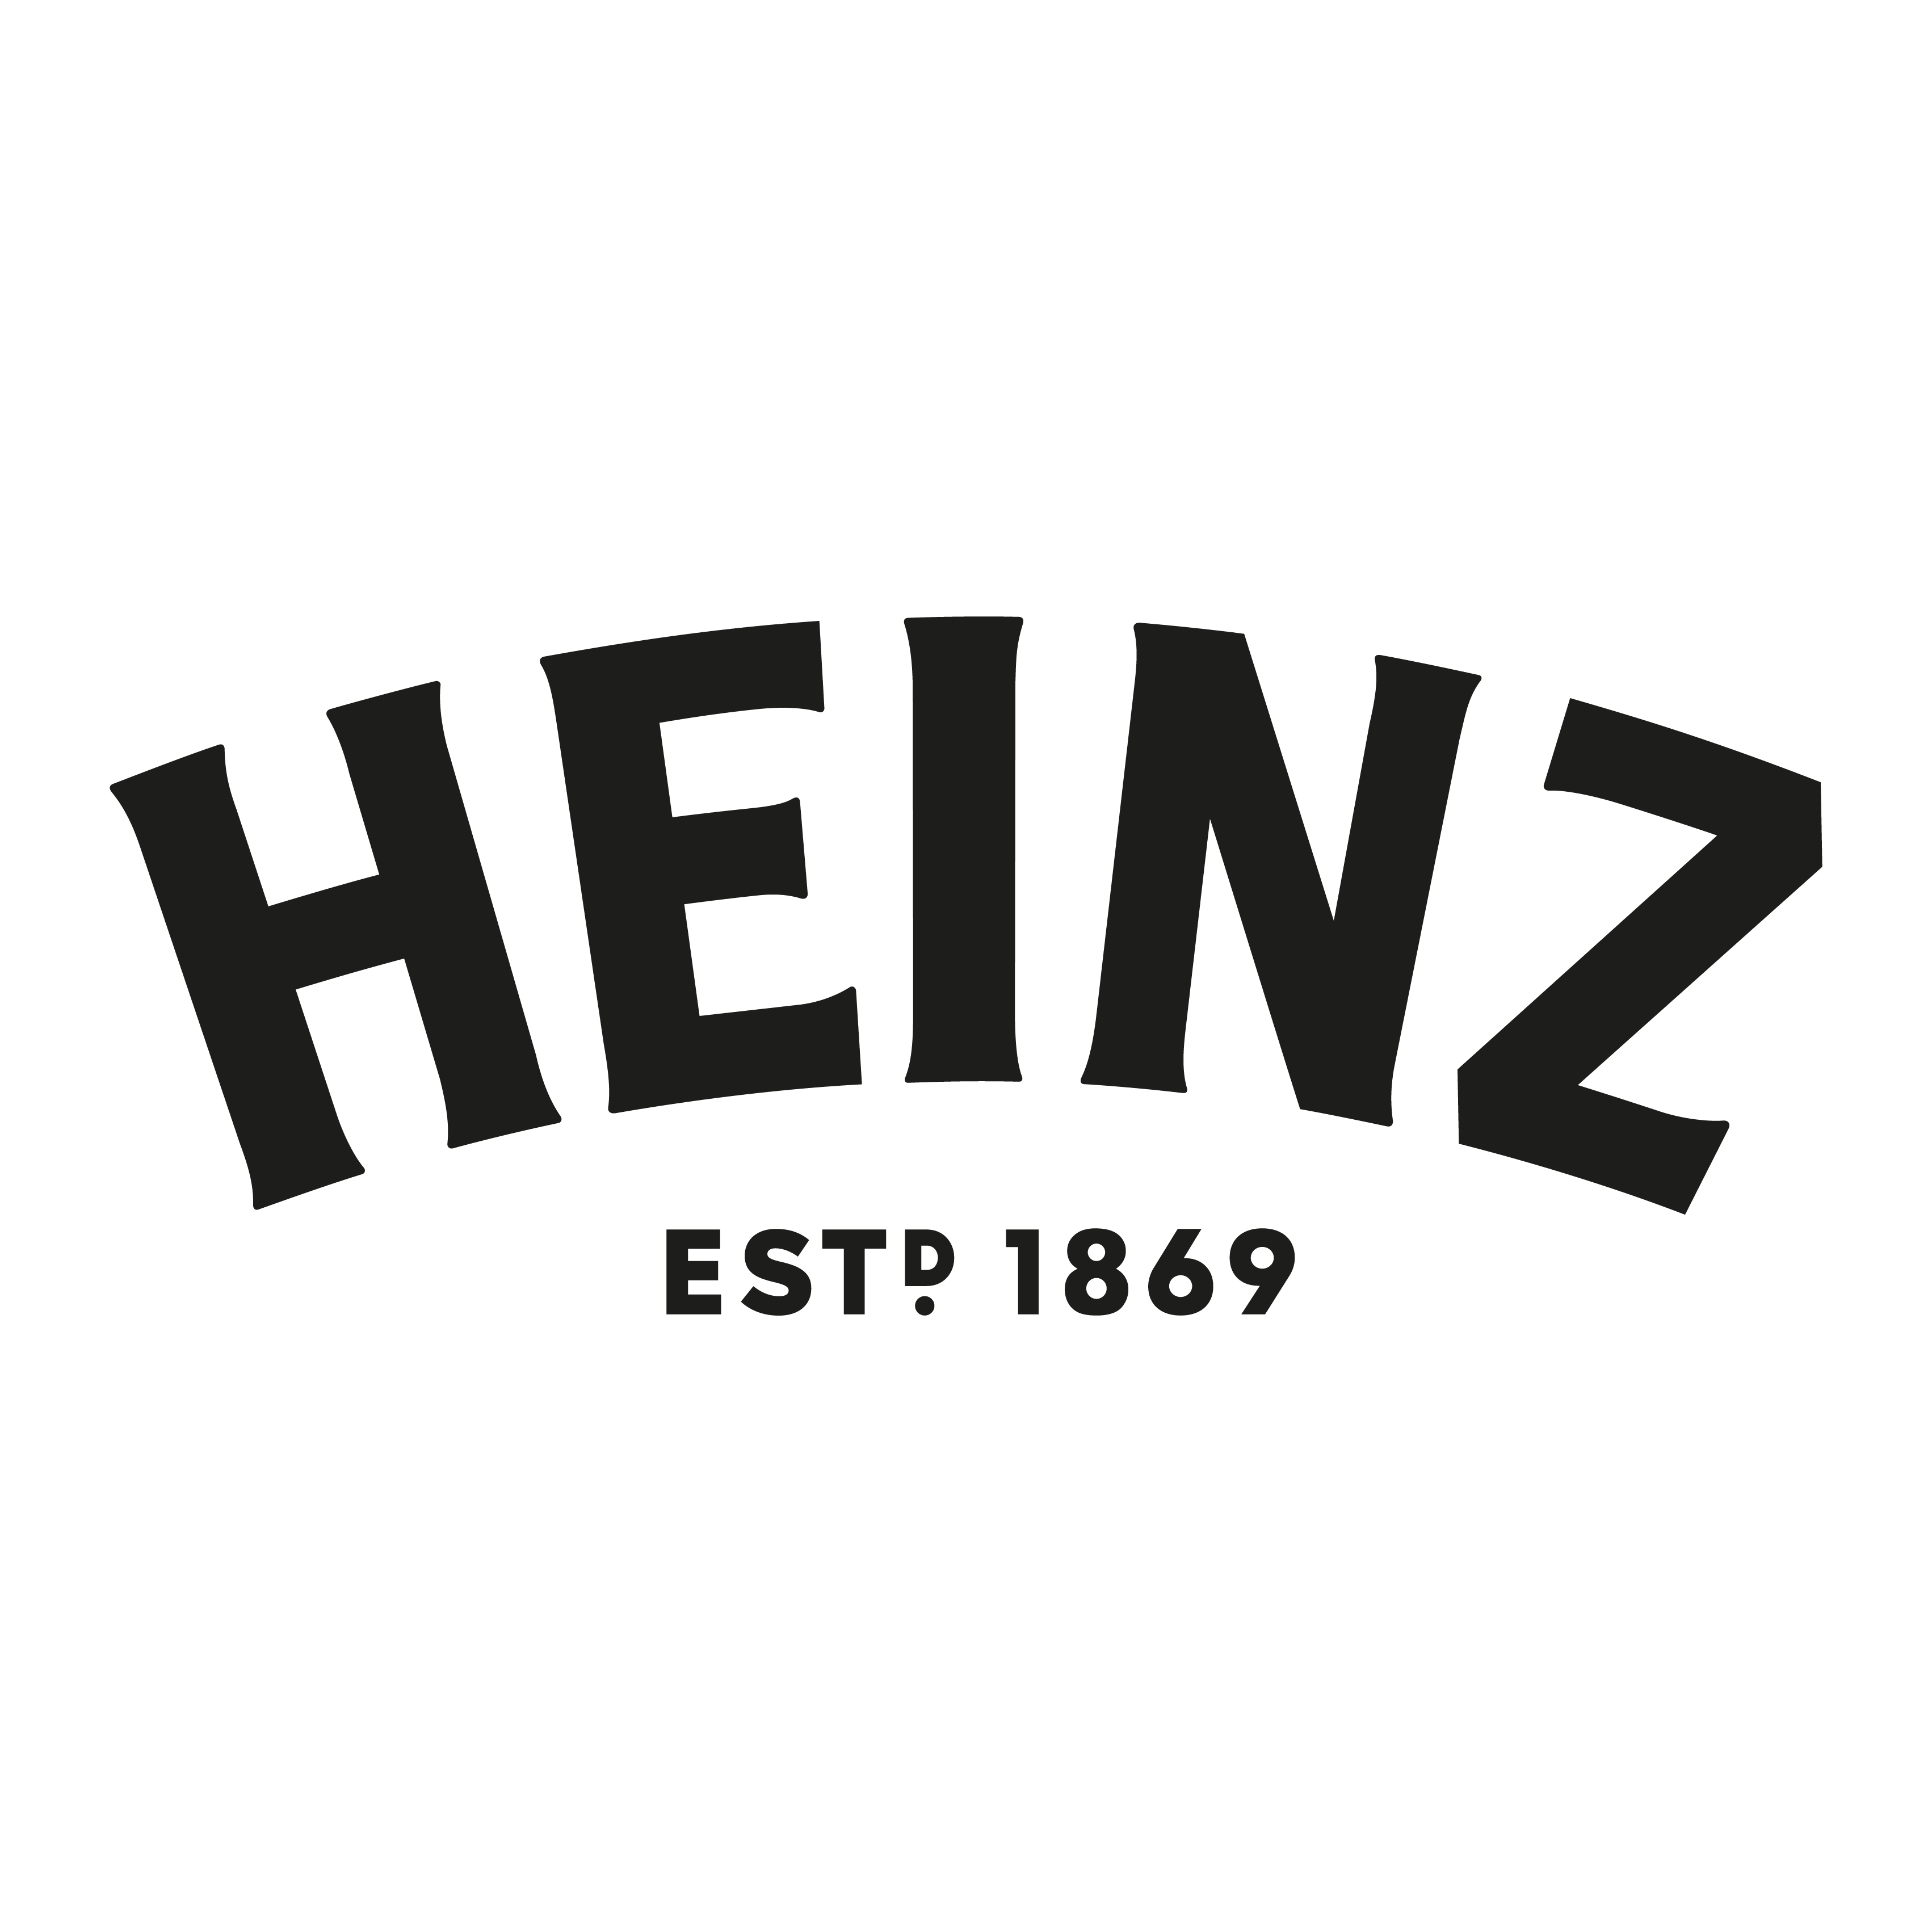
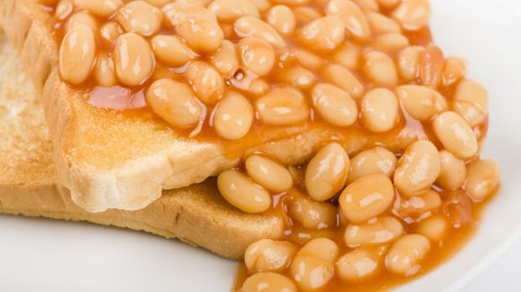
Storyline
The adverts follows a can of beans being shot in an M&S ’Food Porn’ style, the beans are shown of by a spotlight, then poured onto a slice of toast when the line “we can’t make beans sexy, but we can make a great breakfast” as a fork lifts beans from the toast. This piece is supposed to mimic the M&S ads whilst also showing that even though that Beans can not be portrayed attractively that we all still buy them and enjoy them, and have for 150 years.

Slide 3
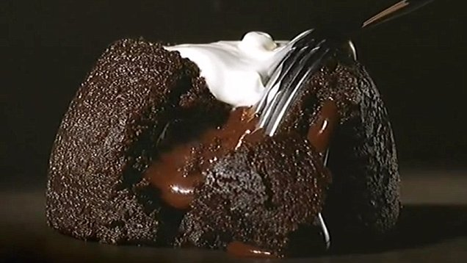
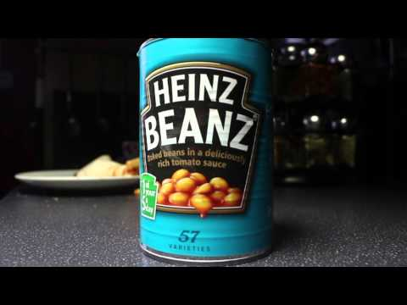
Design & Style
M&S Ads are well known for being successful with their style and tone, with everyone many remembering the 2004 ad from M&S with the anonymous line of “This isn’t just food, this is M&S food.” The food is portrayed in an elegant, if not sensual way, however you cannot make Beans look attractive. So with this I aimed to create an advertisement that mimics the M&S ads, showing that Beans can not be made attractive, however they can still create an excellent breakfast or improve one.
M&S ads are well known and remembered by all, but Heinz ads are also remembered by many, and with combining the style of the M&S ads with Heinz products and charm, then this will be a successful campaign.

Slide 4
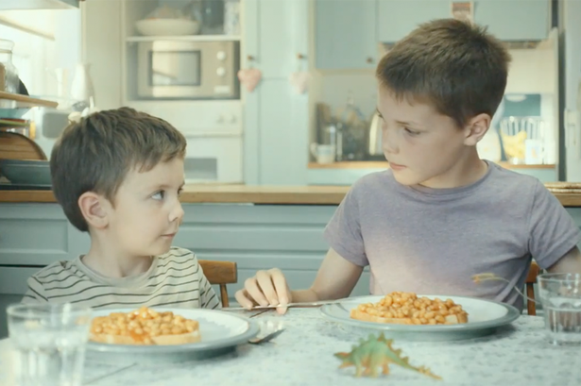
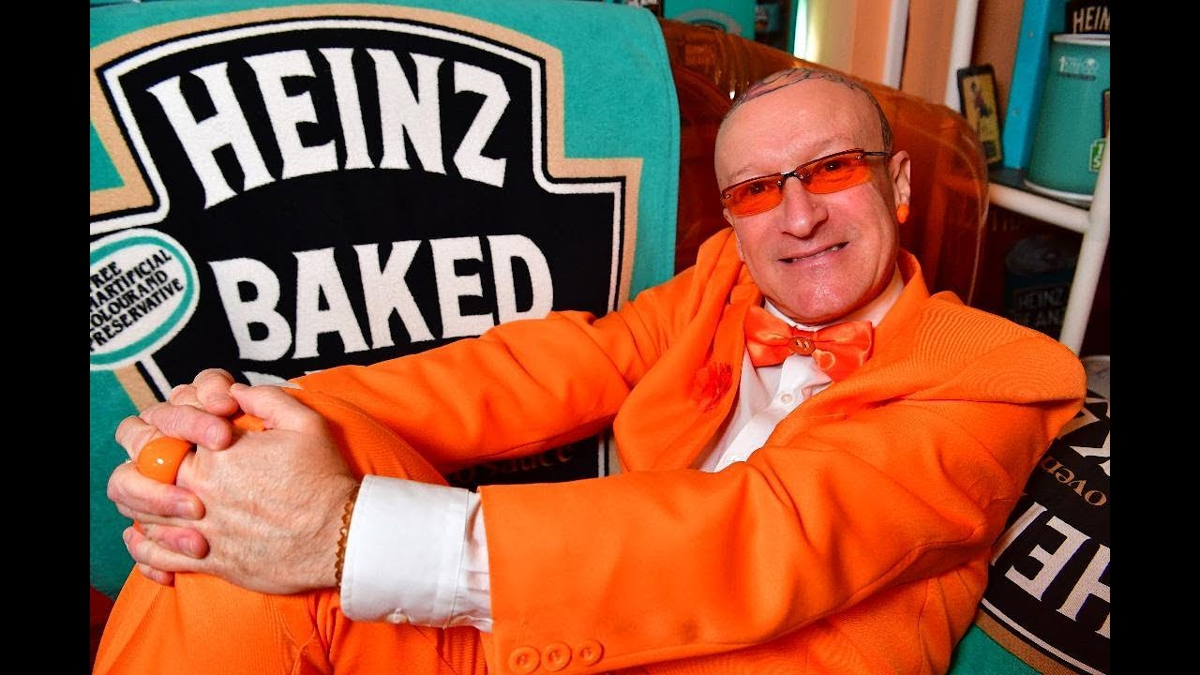
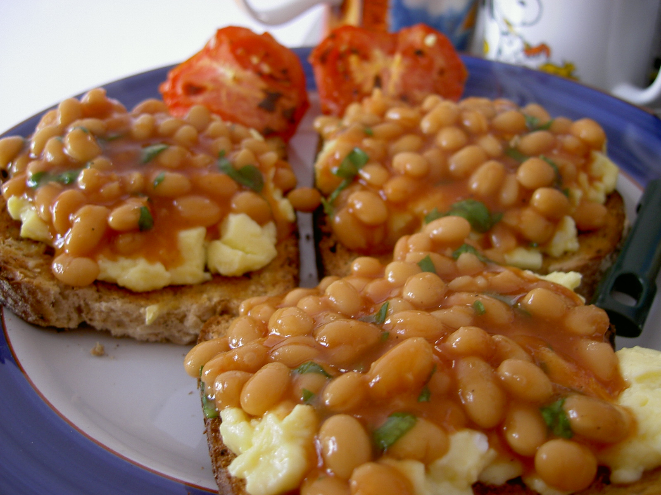
Target Audience
Heinz products, whether they be Beans or Ketchup, have been and will be loved for many years.
They can be enjoyed by families, couples, children, adults, men and women with no exception.
Heinz have been with us since 1869, both World Wars all the way to where we are now, and will continue to be a breakfast staple for the rest of our lives.

Slide 5
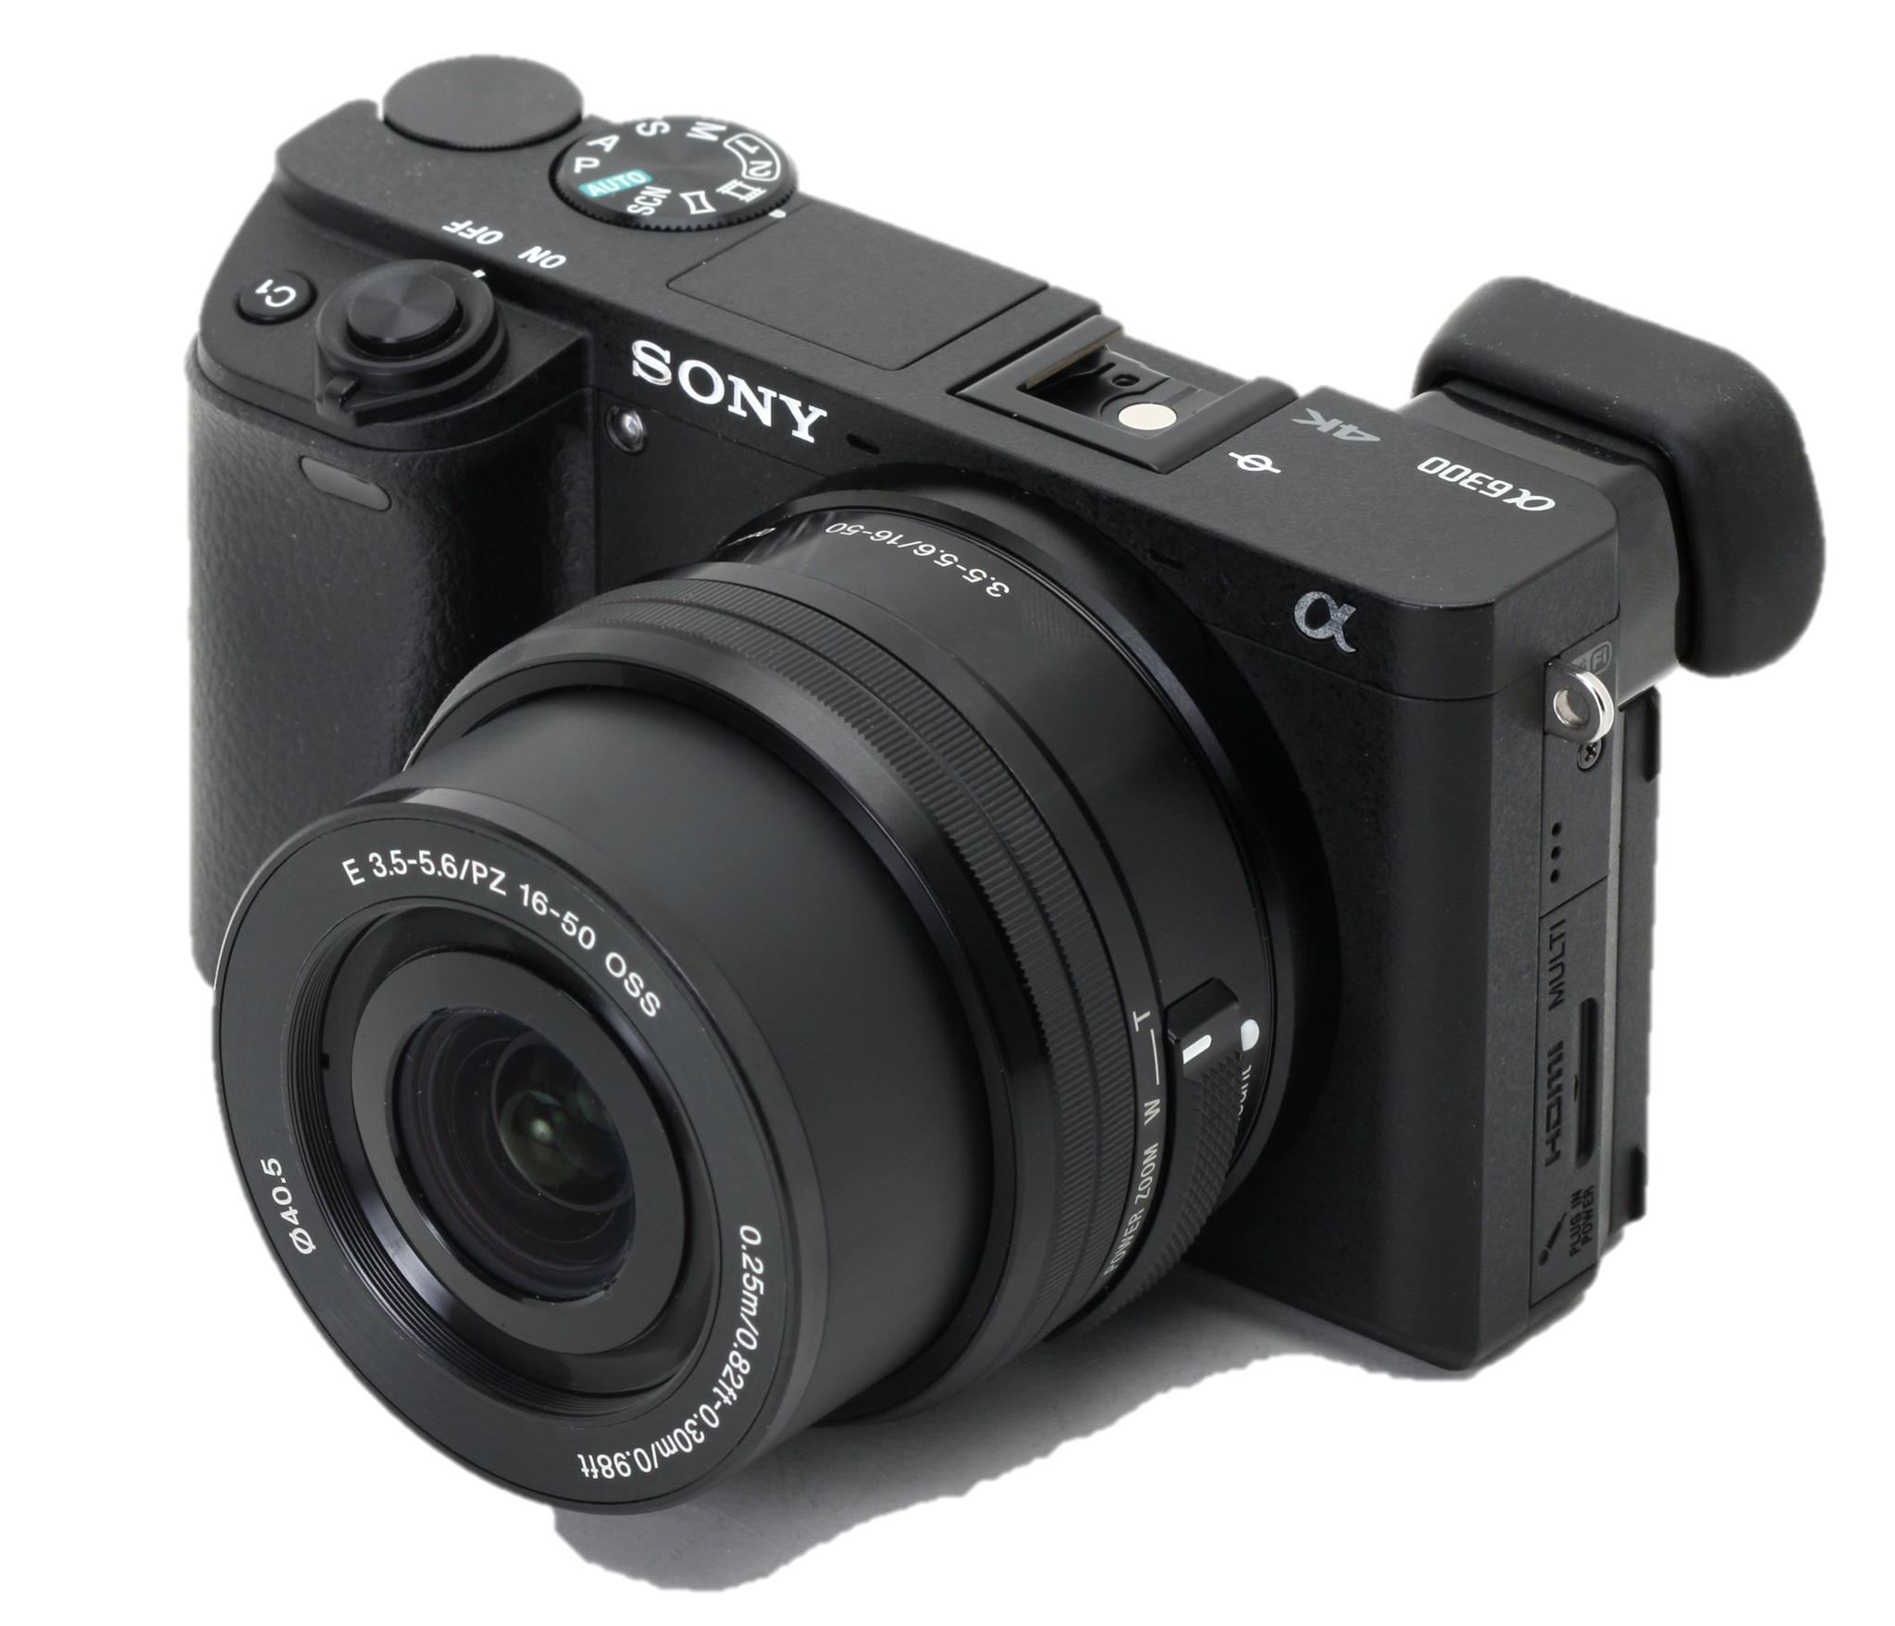
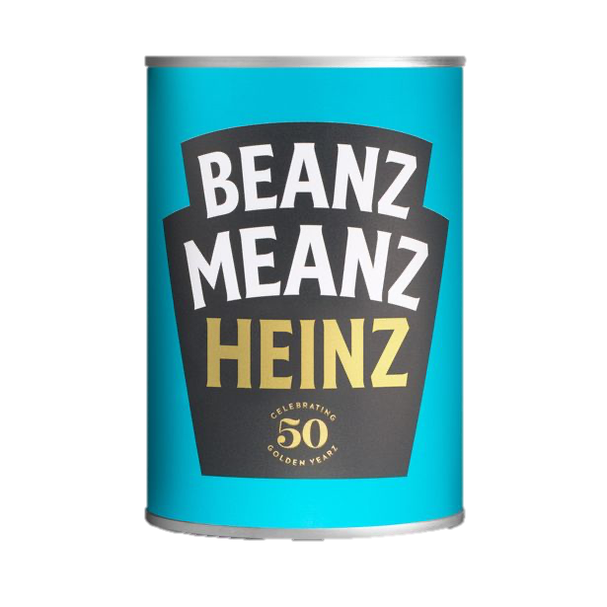

Equipment and Props
Equipment
Sony A6300
Sigma 24mm Prime Lens
Tripod
X2 Studio Lights
128GB SD Card
Adobe Premiere Pro
Props
Heinz Beanz Canned
Fork
Slice of Toast
Plate

